Slide 1


BUA 751 : Machine Learning for Business
Home work 1 – Assignment : Medical Analysis
Group 1
Priyamvada Barve
Nandita Pathardikar
Prasun Abhishek Singh

Slide 2
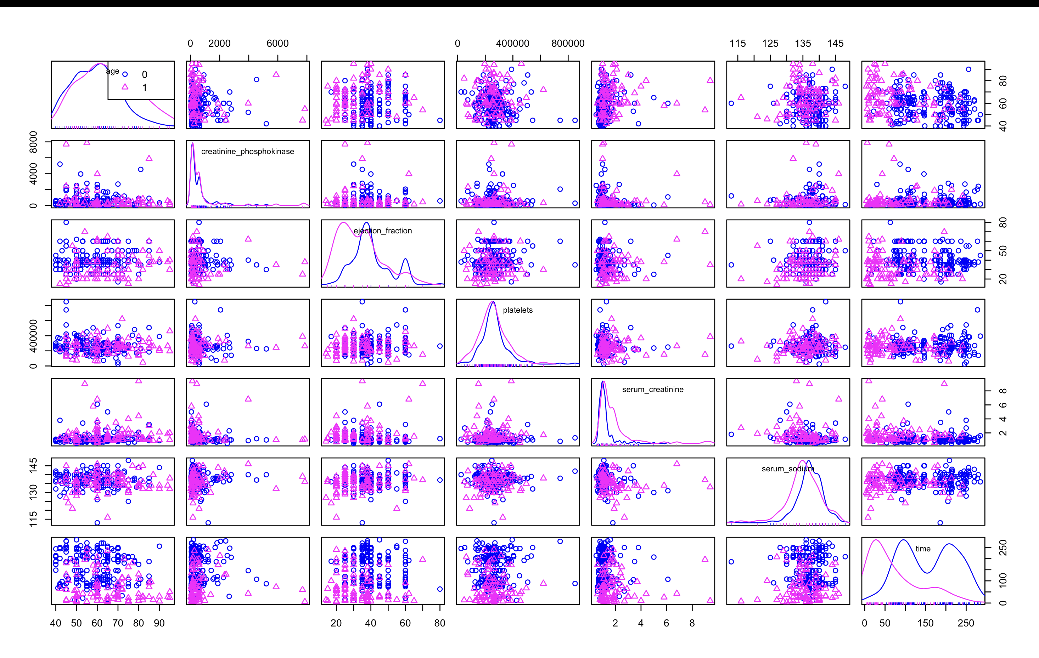
Part 1 : Visualization
In this scatterplot matrix, we observe a considerable amount of data variation. However, specifically on the time column we can notice a pattern where there is a distinct separation among the occurrences of death events. Specifically, with a shorter follow-up time, instances of death are more prominent, whereas the follow-up time extends, individuals tend to remain alive.

Slide 3
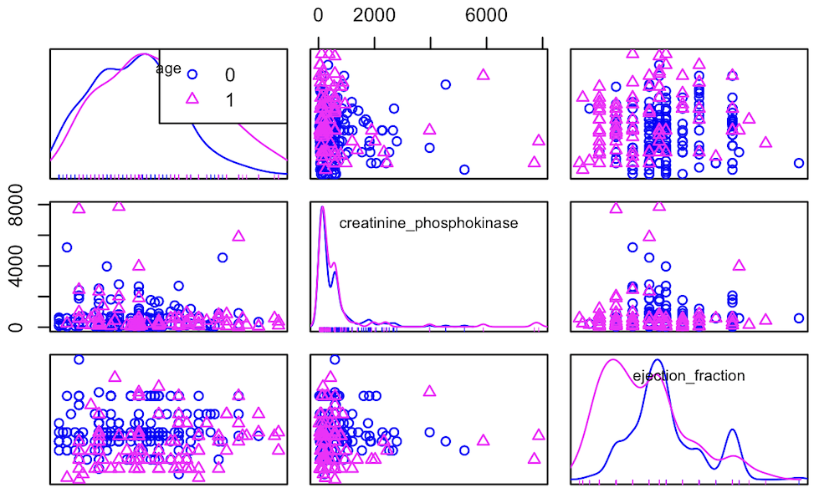

Age VS Ejection Fraction
In this plot, we see that when Age and Ejection Fraction are low the individual tends to stay alive, whereas when both the factors increase, chances of death are higher.

Slide 4
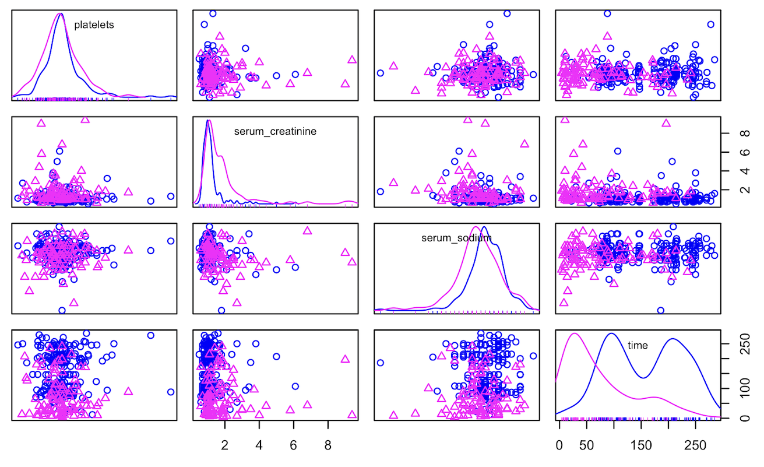

Serum Creatinine VS Time
In this plot, we observe that when the level of serum creatinine is low and the patient does not frequently follow up, then the chances of death are high. But, as the follow up increases, chances of being alive increases.

Slide 5
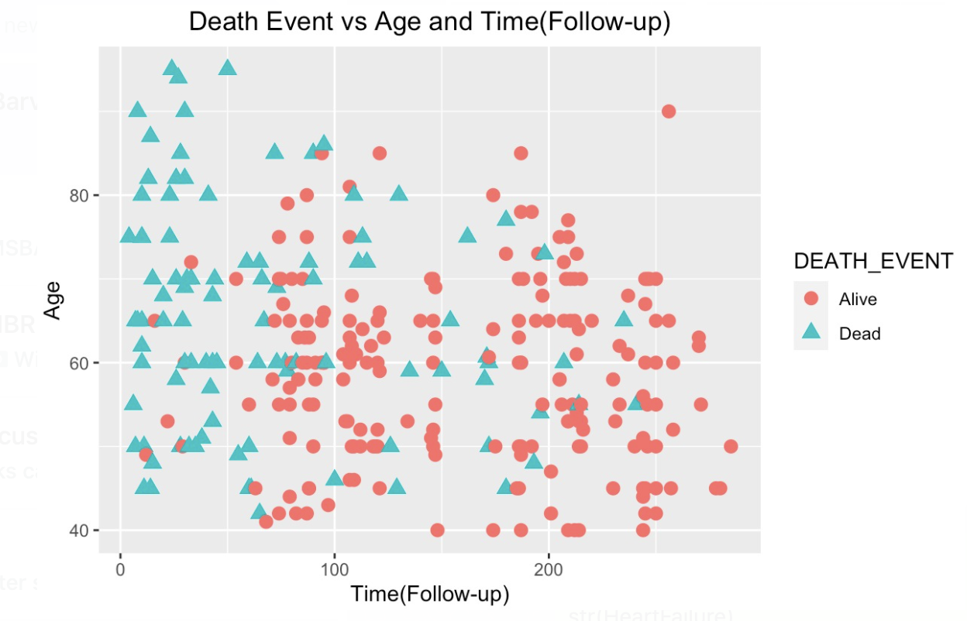
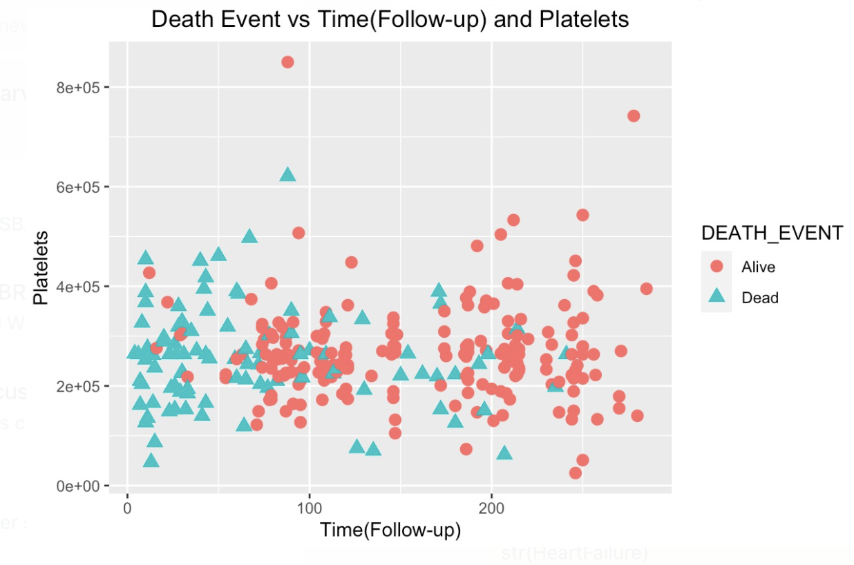

Slide 6
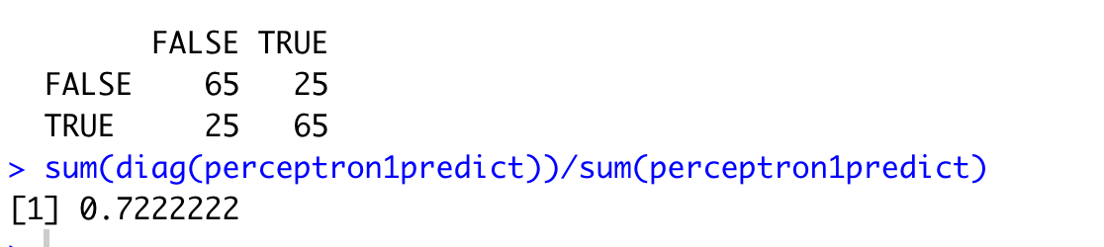
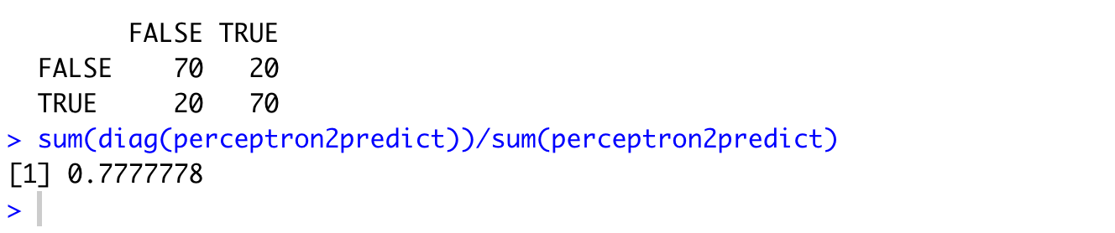
Part 2 : Perceptrons
Age and Serum Sodium
Accuracy – 72%
Age and Time
Accuracy – 78%
From this model we can observe that Age and Time are better predictors for our model, so we should consider them for suture calculations.

Slide 7
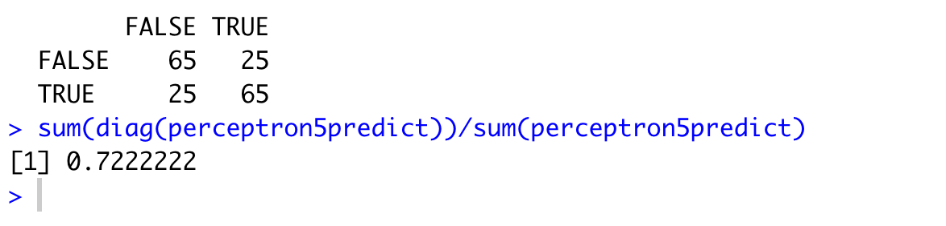
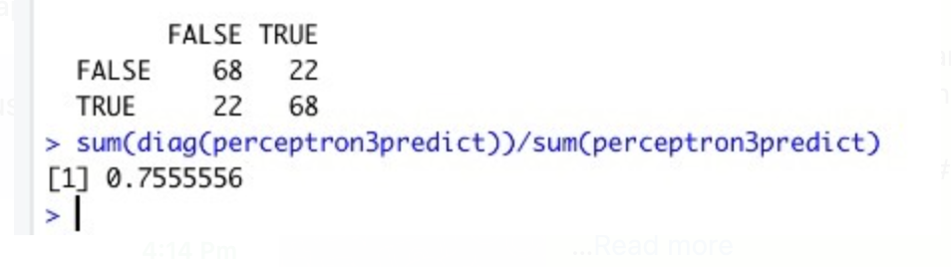
Part 2 : Perceptrons
Age and Ejection Fraction and Time
Accuracy – 72%
Age and Ejection Fraction and Platelets
Accuracy – 75.56%

Slide 8
Part 2 : Perceptrons Summary
When Perceptron is run with 2 variables, Age and Time were the better predictors with the accuracy of 78%.
When Perceptron is run with 3 variables, Age , Ejection Fraction and Platelets turned out to be the better predictors with the accuracy of 75.56%.

Slide 9
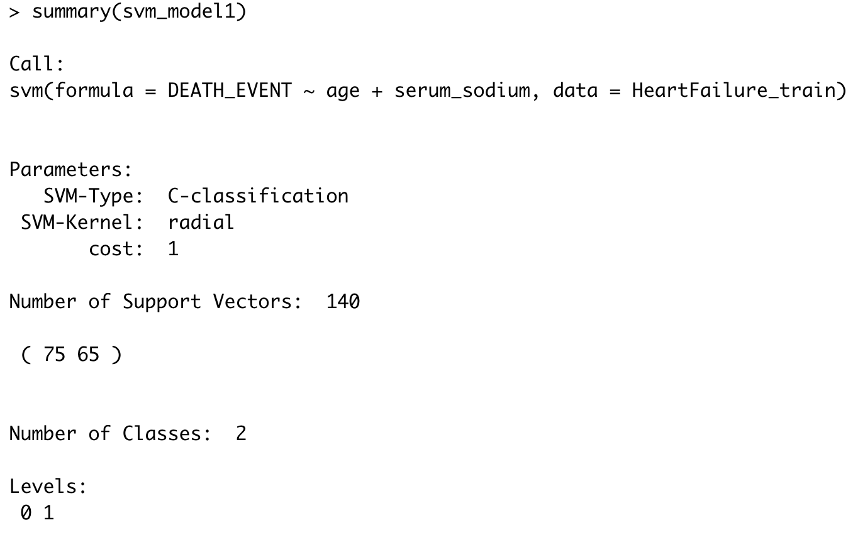
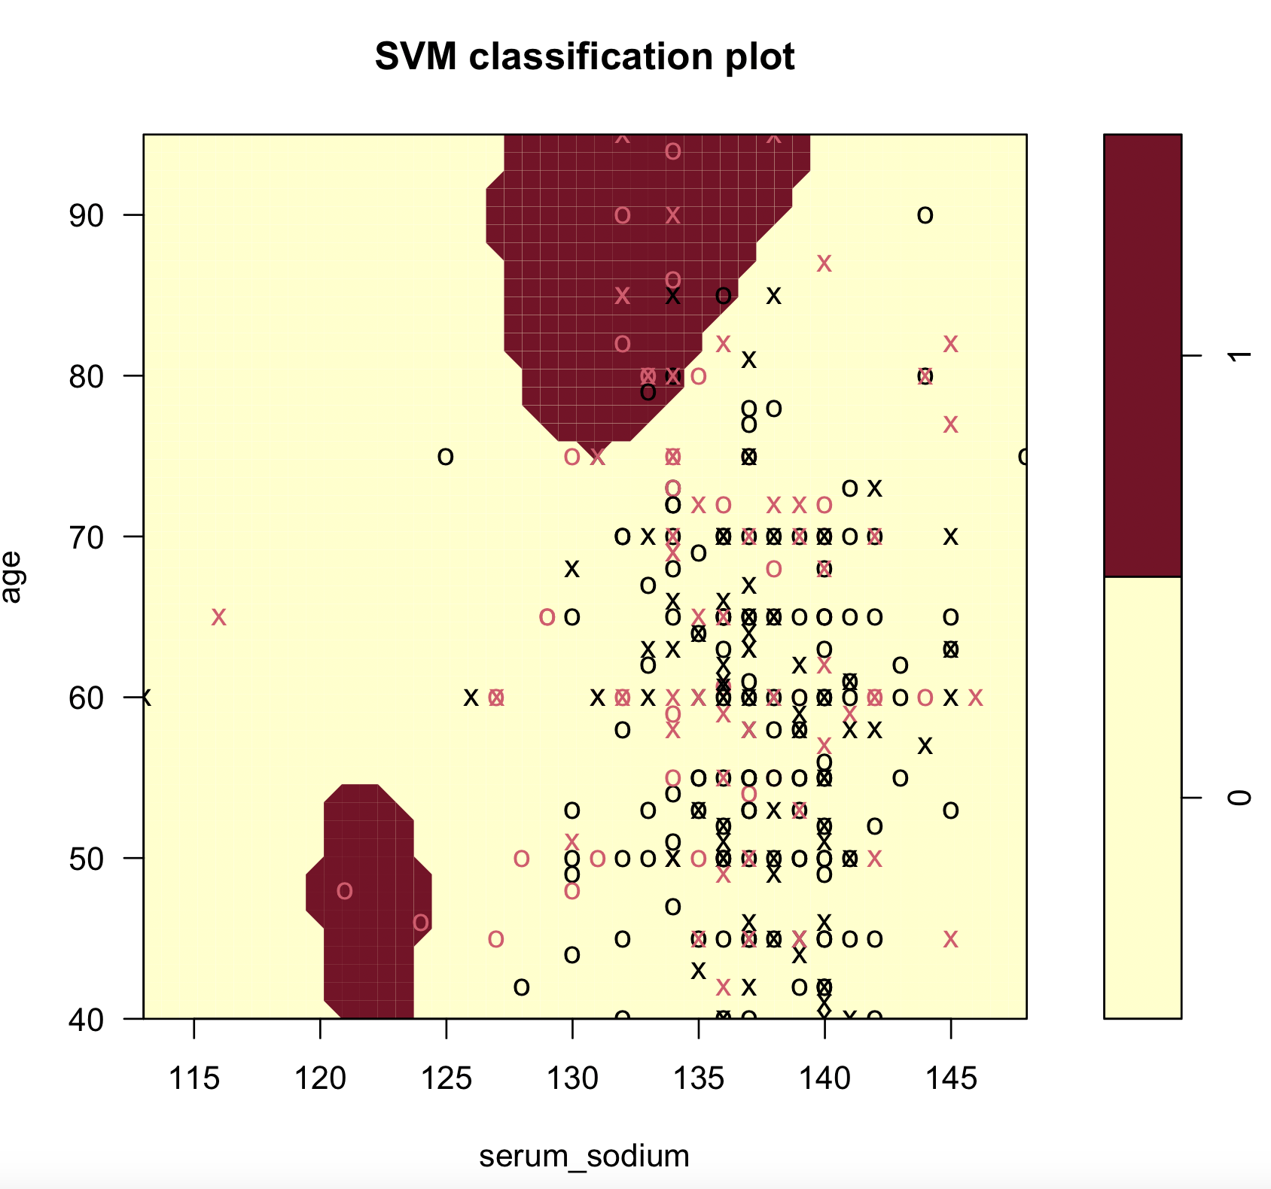
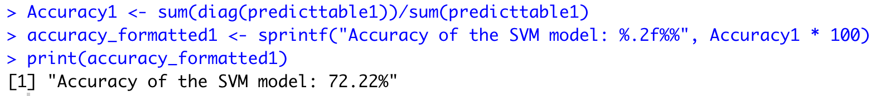
Part 3 : SVM Model (2 Variable)
Death Event VS Age and Serum Sodium
Accuracy – 72.22%

Slide 10
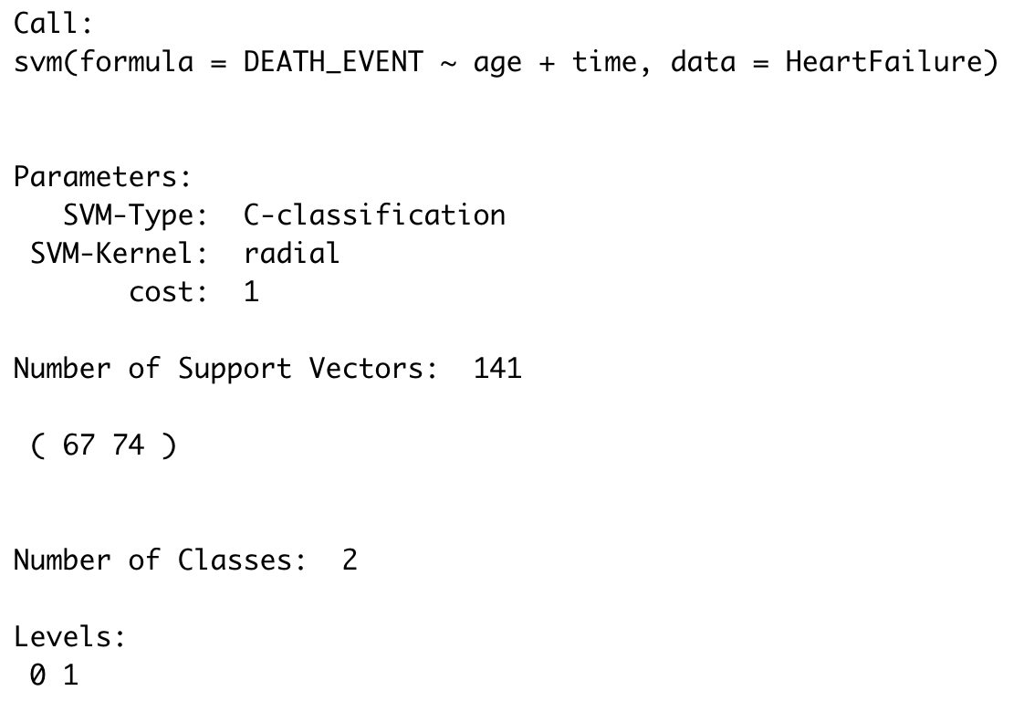
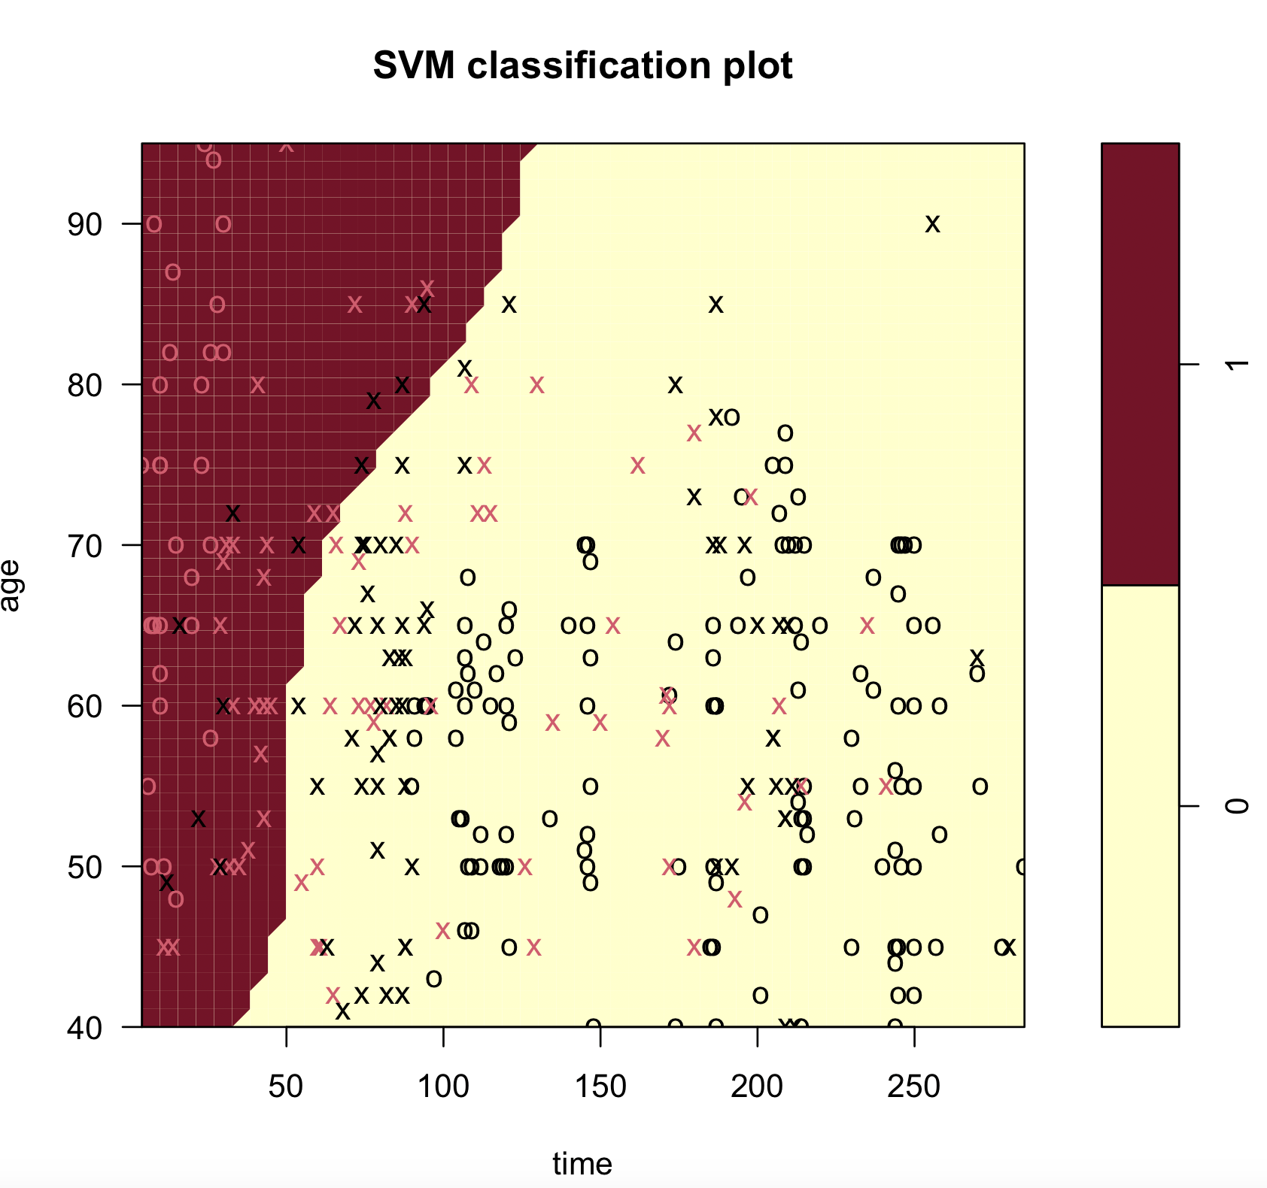
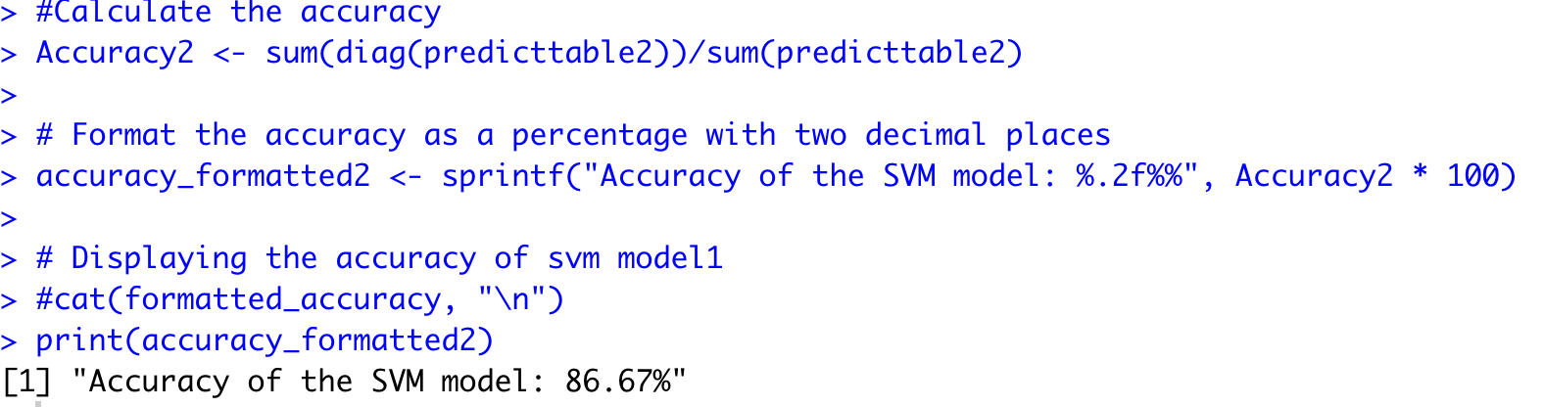
Part 3 : SVM Model (2 Variable)
Death Event VS Age and Time
Accuracy – 86.67%

Slide 11
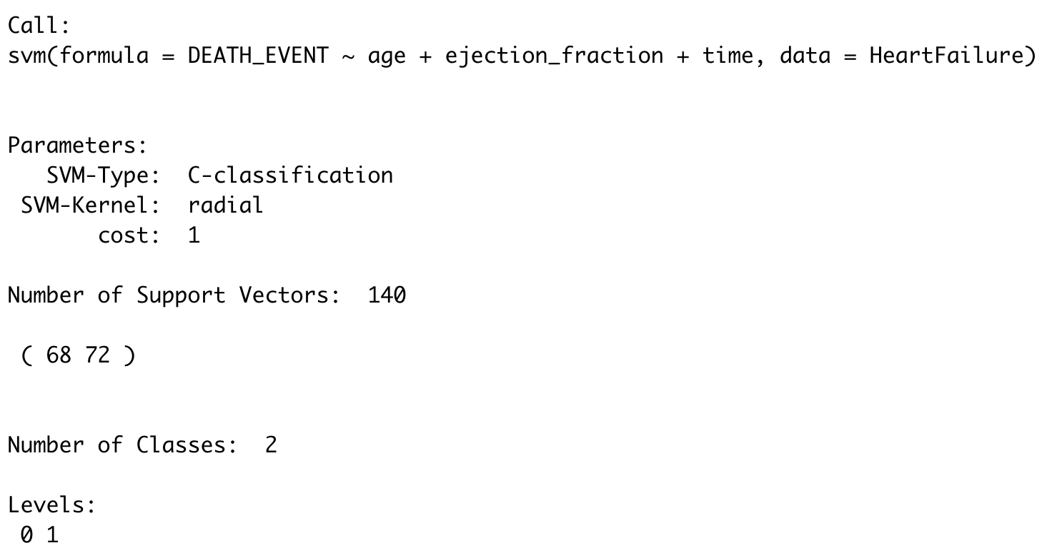
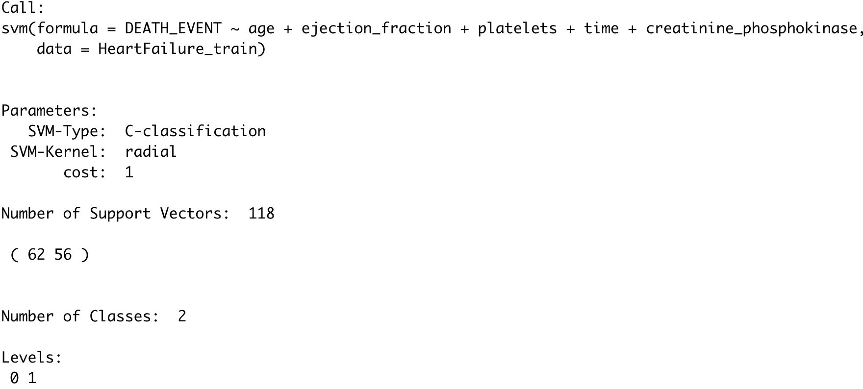
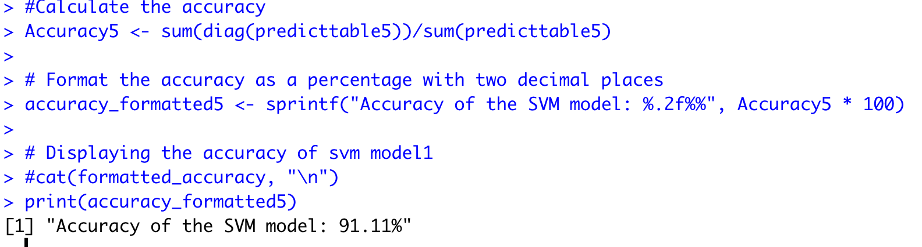
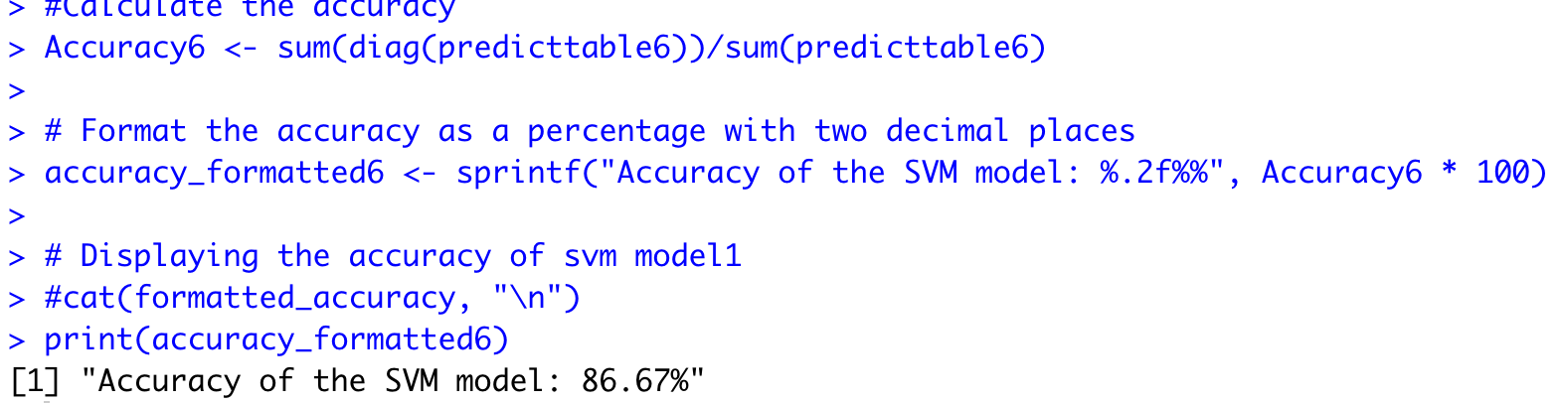
Part 3 : SVM Model (3 Variable)
Death Event VS Age, Time and Ejection Fraction
Accuravcy – 91.11%
Death Event VS Age, Time, Ejection Fraction, Platelets and creatinine phosphokinase
Accuravcy – 86.67%

Slide 12
Part 3 : SVM Model - Summary
When SVM is run with 2 variables, Age and Time were the better predictors with the accuracy of 86.67%.
When SVM is run with 3 variables, Age , Ejection Fraction and Time accuracy came out to be 91.11%.
When SVM is run with 5 variables, Age , Ejection Fraction, Time, Platelets and creatinine phosphokinase accuracy came out to be 86.67%

Slide 13
Part 4 : Lessons Learned
Visualization are particularly valuable when the data points can be grouped into distinct clusters.
In our dataset since there is a lot of noise it wasn’t very clear which variables, when selected were good predictors for out dependent variable. For example, Platelets vs Serum Sodium.

Slide 14
Which Technique Worked ?
Which Did Not ?
Why ?
We observed that SVM model worked better than perceptron, because SVM can handle non-linear relationships when separating relevant groups. SVM is less sensitive to outliers than perceptron.
What other Techniques could be Used
Neural Network and Logistic Regression can also be used as classification techniques.

Slide 15
Thank You

